Slide 1
Real-Time Operating System (RTOS) S. Ramesh

Slide 2
Operating Systems
What is an OS?
Provides an abstraction of the raw computing HW resources (CPU, Memory, Disk, etc.)
Ease of application development
Abstract & Efficient utilization of resources
Reuse of well-proven standard functions
OS structured as a layered architecture
core or kernel performing basic function
a series of outer shells: I/O, user functions

Slide 3
Abstract Architecture
Applications
User Interface
File and Disk I/Ot
Kernel
Hardware

Slide 4
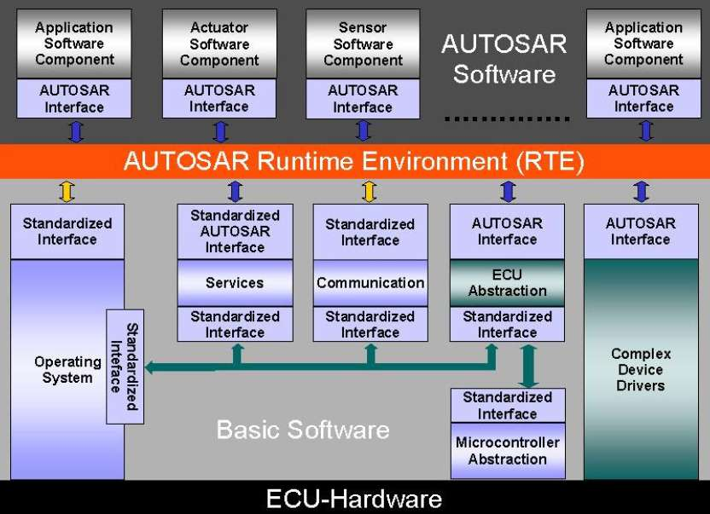
Concrete Architecture -Automotive

Slide 5
Layered Architecture
Each layer uses the services of lower layer and provides service to the upper layer
Service are in the form of function calls
Kernel provides basic functions
task management, scheduling, communication
Timer services
External I/O management
System calls and APIs
RTOS usually has only the kernel

Slide 6
Kernel Functions
System Calls
Clock Interrupts
External Interrupts
Task, Time and other I/O services5
Timer Service & Scheduling
Interrupt Servicing & Scheduling

Slide 7
Task Management
Task is a sequential computation
Time or event triggered
Task may be running or wait for I/O or other tasks
Tasks may be created or destroyed
Task behavior realized by the OS or RTOS

Slide 8
Task State Machine (Simplified)
Ready
Executing
Waiting/Suspended

Slide 9
Managing the tasks
A task when it enters the system is either in waiting or ready state
It is in ready state when it is ready for execution but some other task is currently executing
It can go to executing state only from ready state
An executing task can be preempted by hi-priority tasks and may enter the ready state
An executing task goes to waiting state when an input or resource required for execution
Component of RTOS which manages the tasks is called the scheduler

Slide 10
Preemption
When is a task preempted?
When it requires a new input/event?
When a hi-priority task is ready
When a shared resource is not ready
Printers, network interface buffers etc.
When a time slice for a task expires
Round robin scheduling of tasks
Preemption is often asynchronous and one has to assume the worst can happen
Just when a memory read has happened
Saving grace is that it happens in instruction boundaries
What instructions? High Level instructions?
No machine level instructions
Controlled preemption is essential to predict the results of computation

Slide 11
Context-switching
What happens when an executing task T1 is pre-empted by another task T2
The state of T1 needs to be saved so that when T1 is resumed later, it resumes from where it left
What decides the state of a task
Its control point
All the register values
The stack
What about memory?
Memory is often shared among the tasks
It could be changed by new running tasks
It is used for communication between tasks
So no memory copy is made
The result is that memory would contain arbitrary value on resumption

Slide 12
Task Control Block (TCB)
Stores the entire state of a task
.
.
TID
SAVED_TASK_STATE
Resource 1 (signals)
Resource 2 (events)
Resource 3 (shared memory)
System Variables

Slide 13
Task Timing Diagrams
T4
T3
T2
Preemption
Resumption
T1
Response Time of T1

